Slide 1

SMART ANALYTICS FOR A VEGETABLE SELLER
Diploma in Data Science
Business Data Management Project | BSMS2001P
INDIAN INSTITUTE OF TECHNOLOGY, MADRAS
CHENNAI - 600036
Anuj Krishna S - [21F2000852]
21f2000852@ds.study.iitm.ac.in
Date: 25/05/2025

Slide 2
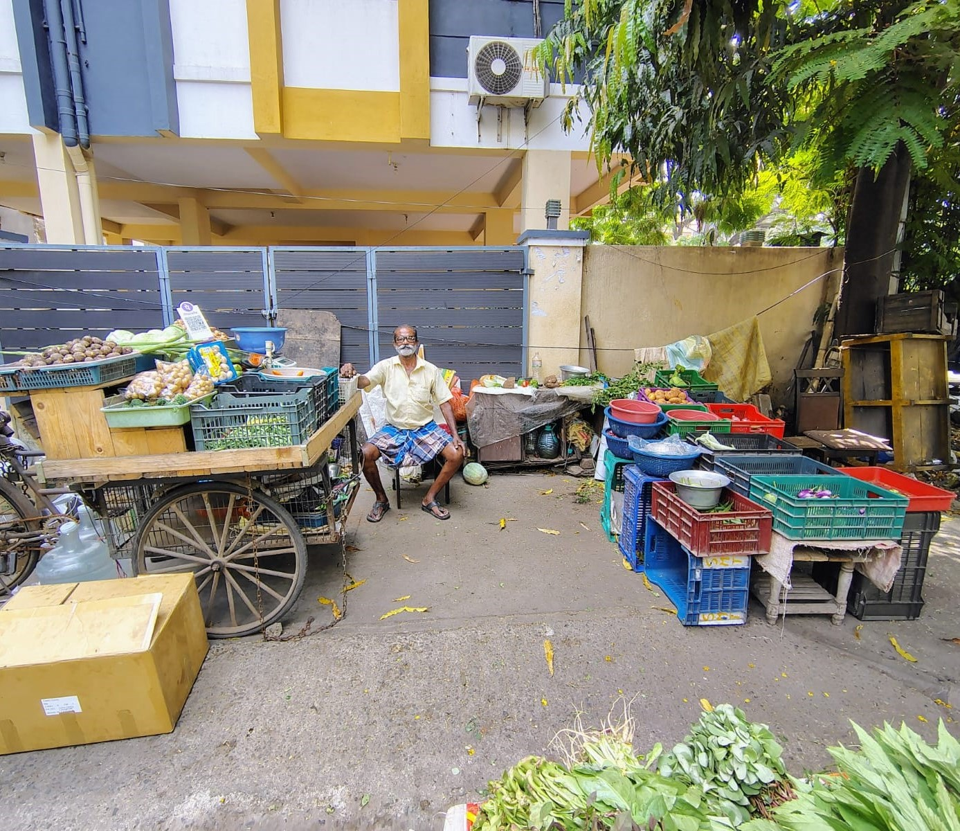
ABOUT THE BUSINESS
Mr. Muthuraj A, a long-time Chennai resident, has run a roadside vegetable shop in Ashok Nagar 7th, Avenue for over 35 years. Specializing in fresh vegetable retail. The shop serves local customers with a focus on quality and community trust.
As a sole proprietor, he has built his business through experience, intuition, and routine, rather than formal methods, making his approach deeply rooted in local trust and tradition.

Slide 3
PROBLEMS FACED
1. STAGNANT SALES:
Mr. Muthuraj faces stagnant sales and seeks data-driven strategies to boost revenue, attract customers, and enhance profitability.
2. STOCK WASTAGE:
Mr. Muthuraj faces high daily stock wastage, and aims to reduce losses through improved inventory management and smarter sales strategies.

Slide 4
ANALYSIS OVERVIEW
1. CUSTOMER PATTERN CLUSTERING - ( K means)
2. ABC ANALYSIS
3. STOCK OPTIMIZATION STRATEGY
4. RECOMMENDATIONS

Slide 5
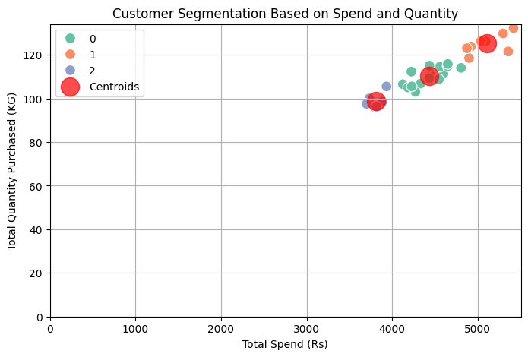

Customer Pattern Clustering
1. K-means clustering was applied to segment customers based on their spending and purchase quantity.
2. Customers in cluster 0 purchase in bulk but at a medium spending level.
3. Customers in cluster 1 exhibit high spending and purchase large quantities.
4. Cluster 2 comprises customers who spend relatively less.
Cluster Summary

Slide 6
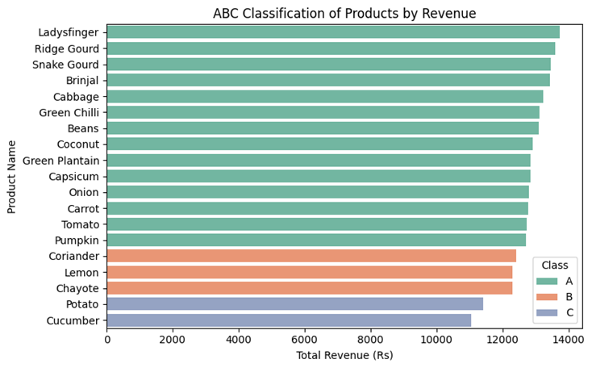
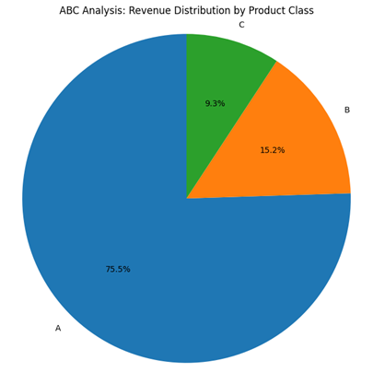
ABC Analysis
1. Products are classified into three categories A, B, and C with Class A generating the highest revenue and Class C the lowest.
2. It allows businesses to focus their attention and resources on the items that have the greatest impact on profitability.
3. By optimizing inventory control, businesses can reduce carrying costs, ordering costs, and the risk of stockouts.

Slide 7
Stock Optimization Strategy
1. Daily Average Sales: Calculate a 7-day rolling average to estimate the quantity of each product sold daily. This approach captures recent demand trends.
2. Reorder Point (ROP): ROP=Average Daily Sales * Lead Time.
3. Perishability Classification: Classify each product based on its perishability (High, Medium, Low).
4. Adjusted Optimal Stock Level: Adjust the order quantity based on the perishability classification.

Slide 8
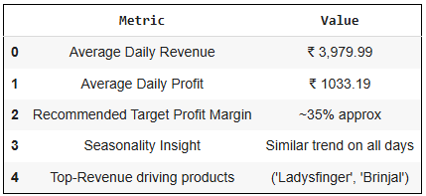
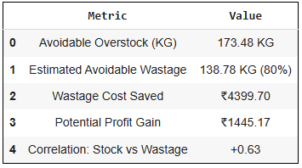
ANALYSIS SUMMARY
Problem Statement 1
Problem Statement 2

Slide 9
RECOMMENDATIONS
Problem Statement 1
Problem Statement 2
1. Maintain ~35% margin to consistently achieve daily profits of ₹1350–₹1450, leading to monthly income of ₹38,000–₹40,000.
2. Target the high spenders with loyalty programs to retain them and encourage repeat business.
3. Encourage the low spending customers with discounts or small bundles to increase their spending.
4. Street hawking techniques allow flexible location-based selling, boosting sales in high-demand areas.
1. Implement dynamic stock optimization using rolling average sales and perishability scoring to calculate daily reorder quantities.
2. Focus inventory control efforts on ‘A’ class products in ABC analysis that contribute to 80% of revenue. (i.e.) Tomato, Lady’s Finger.
3. Products like capsicum and carrot should be stocked 20%–30% less than others due to spoilage risks.

Slide 10
THANK YOU
Name: Anuj Krishna S
Email: 21f2000852@ds.study.iitm.ac.in
Phone: +91 9025778773
Linkedin: https://www.linkedin.com/in/anujkrish/

